Slide 1
RENAL AND GENITAL-URINARY DISEASES
MR. CHOGE

Slide 2
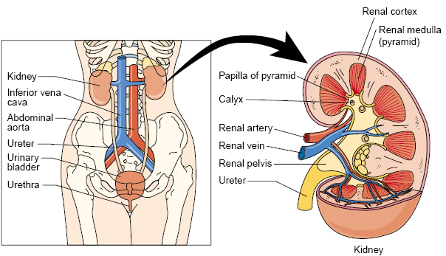
Anatomic and Physiologic

Slide 3
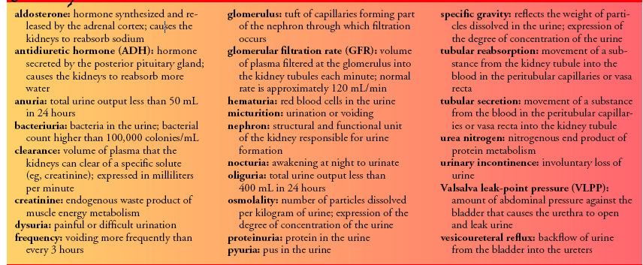
DEFINITION OF TERMS

Slide 4
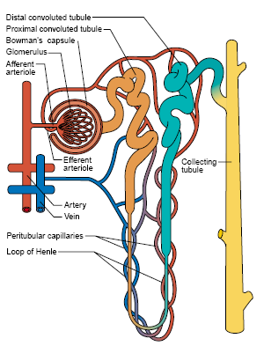
URINE FORMATION

Slide 5
Urine is formed in the nephrons through a complex three-step process: glomerular filtration, tubular reabsorption, and tubular secretion
The various substances normally filtered by the glomerulus, reabsorbed by the tubules, and excreted in the urine include sodium, chloride, bicarbonate, potassium, glucose, urea,creatinine, and uric acid.

Slide 6
Within the tubule, some of these substances are selectively reabsorbed into the blood. Others are secreted from the blood into the filtrate as it travels down the tubule.
Some substances, such as glucose, are completely reabsorbed in the tubule and normally do not appear in the urine.
Glucose, however, appears in the urine (glycosuria) if the amount of glucose in the blood and glomerular filtrate exceeds the amount that the tubules are able to reabsorb

Slide 7
In diabetes, when the blood glucose level exceeds the kidneys’ reabsorption capacity, glucose appears in the urine. Glycosuria is also common in pregnancy.
Protein molecules are also generally not found in the urine; however, low-molecular-weight proteins (globulins and albumin) may periodically be excreted in small amounts.

Slide 8
Functions of the Kidney
• Urine formation
• Excretion of waste products
• Regulation of electrolytes
• Regulation of acid–base balance
• Control of water balance
• Control of blood pressure
• Renal clearance
• Regulation of red blood cell production
• Synthesis of vitamin D to active form
• Secretion of prostaglandins

Slide 9
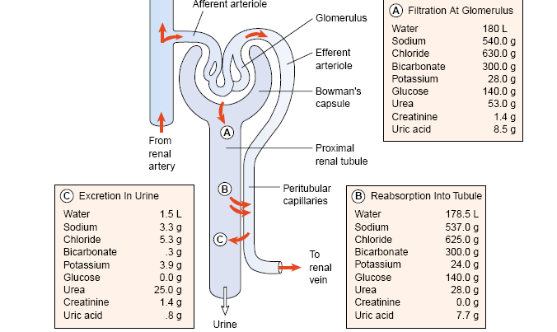
FORMATION OF URINE IN THE NEPHRON

Slide 10
Review the genital urinary examinations/tests
Intravenous Urography
Intravenous urography includes various tests such as excretory urography, intravenous pyelography (IVP) and infusion drip pyelography.
A radiopaque contrast agent is administered intravenously. An IVP, or intravenous urogram, shows the kidneys, ureter, and bladder via x-ray imaging as dye moves through the upper and then lower urinary system.

Slide 11
2. Cystography
Cystography aids in evaluating vesicoureteral reflux (backflow of urine from the bladder into one or both ureters) and assessing the patient for bladder injury.
A catheter is inserted into the bladder, and a contrast agent is instilled to outline the bladder wall. The contrast agent may leak through a small bladder perforation stemming from bladder injury, but such leakage is usually harmless.

Slide 12
3. Cystoscopic
The cystoscopic examination is used to directly visualize the urethra and bladder.
The cystoscope, which is inserted through the urethra into the bladder, has a self-contained optical lens system that provides a magnified, illuminated view of the bladder

Slide 13
4. BIOPSY Renal and Ureteral Brush Biopsy
Brush biopsy techniques provide specific information when abnormal x-ray findings of the ureter or renal pelvis raise questions about whether the defect is a tumor, a stone, a blood clot, or an artifact.
First, a cystoscopic examination is conducted. Then, a ureteral catheter is introduced, followed by a biopsy brush that is passed through the catheter.

Slide 14
The suspected lesion is brushed back and forth to obtain cells and surface tissue fragments for histologic analysis.
After the procedure, intravenous fluids may be administered to help clear the kidneys and prevent clot formation.

Slide 15
Kidney Biopsy
Biopsy of the kidney is used in diagnosing and evaluating the extent of kidney disease.
Indications for biopsy include unexplained acute renal failure, persistent proteinuria or hematuria, transplant rejection, and glomerulopathies.

Slide 16
KFTs
Contents:
Functional units
Kidney functions
Routine kidney function tests (KFTs):
Serum creatinine
Creatinine clearance
Cockcroft-Gault formula for GFR estimation
Serum Urea

Slide 17
The volume of blood filtered per minute is the glomerular filtration rate (GFR), and its determination is essential in evaluating renal function.

Slide 18
Why test the renal functions?
Many diseases affect renal function.
In some, several functions are affected.
In others, there is selective impairment of glomerular function or one or more of tubular functions.
Most types of renal diseases cause destruction of complete nephron.

Slide 19
Routine KFTs include the measurement of :
Serum creatinine (Cr).
Creatinine clearance.
Serum urea.

Slide 20
Both serum Cr and creatinine clearance are used as kidney function tests to :
Confirm the diagnosis of renal disease.
Give an idea about the severity of the disease.
Follow up the treatment.

Slide 21
Serum creatinine (55-120 μmol/L in adult):
Creatinine is the end product of creatine catabolism.
98% of the body creatine is present in the muscles where it functions as store of high energy in the form of creatine phosphate.
About 1-2 % of total muscle creatine or creatine phosphate pool is converted daily to creatinine through the spontaneous, non enzymatic loss of water or phosphate.

Slide 22
UPPER URINARY TRACT INFECTION: ACUTE PYELONEPHRITIS
bacterial infection of the renal pelvis, tubules, and interstitial tissue of one or both kidneys.
Bacteria reach the bladder by means of the urethra and ascend to the kidney.
Pyelonephritis is frequently secondary to ureterovesical reflux, in which an incompetent ureterovesical valve allows the urine to back up (reflux) into the ureters

Slide 23
Urinary tract obstruction, bladder tumors, strictures, benign prostatic hyperplasia, and urinary stones are some of the other causes.

Slide 24
Clinical Manifestations
Enlarged kidneys with interstitial infiltrations of inflammatory cells.
Abscesses may be noted on the renal capsule.
The patient appears acutely ill with:
chills and fever,
leukocytosis,
bacteriuria
pyuria, flank pain,
CVA tenderness.

Slide 25
Assessment and Diagnostic Findings
An ultrasound study or a CT --to locate any obstruction in the urinary tract
Urine culture and sensitivity tests are performed to determine the causative organism so that appropriate antimicrobial agents can be prescribed.

Slide 26
Medical Management
Usually treated as outpatients if they are not dehydrated, not experiencing nausea or vomiting, and not showing signs or symptoms of sepsis.
all pregnant women, may be hospitalized for at least 2 or 3 days of parenteral therapy.
a 2-week course of antibiotics is recommended
Commonly prescribed agents include
ciprofloxacin, gentamicin with or without
ampicillin, or a third-generation cephalosporin

Slide 27
NEPHROTIC SYNDROME
is a primary glomerular disease characterized by :
Marked increase in protein in the urine (proteinuria)
Decrease in albumin in the blood(hypoalbuminemia)
Edema

Slide 28
Pathophysiology
nephrotic syndrome does occur in adults, including the elderly. Causes:
chronic glomerulonephritis,
diabetes mellitus with intercapillary glomerulosclerosis, amyloidosis of the kidney,
systemic lupus erythematosus,
multiple myeloma, and renal vein thrombosis.

Slide 29
characterized by the loss of plasma protein, particularly albumin, in the urine.
Although the liver is capable of increasing the production of albumin, it cannot keep up with the daily loss of albumin through the kidneys. Thus, hypoalbuminemia results

Slide 30
Clinical Manifestations
major manifestation of nephrotic syndrome is edema.--soft and pitting andcommonly around the eyes (periorbital),
in dependent areas (sacrum, ankles, and hands), and in the abdomen (ascites).
Other symptoms, including malaise, headache, irritability, and fatigue, are common

Slide 31
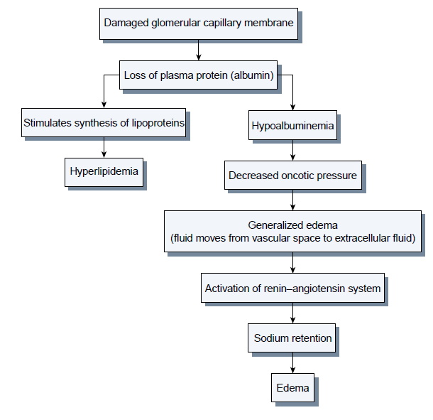

Slide 32
Assessment and Diagnostic Findings
Proteinuria (predominately albumin) 3.5 g/day
A needle biopsy of the kidney may be performed for histologic examination of renal tissue to confirm the diagnosis.

Slide 33
Medical Management
Aims at preserving the renal function.
Diuretic agents may be prescribed for the patient with severe edema---hypovolemia
(ACE) inhibitors in combination with diuretics often reduces the degree of proteinuria

Slide 34
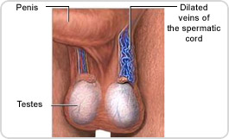
Varicocele

Slide 35
Definition
Etiology
Pathophysiology of testicular changes
Clinical features
Investigations
Treatment –
- Expectant treatment
- Indication of intervention
- Treatment options
- Complication of surgery
Complication of untreated varicocele

Slide 36
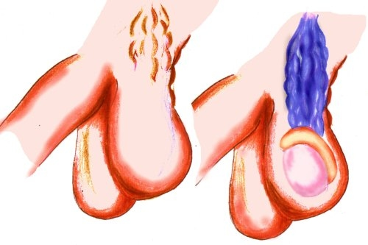
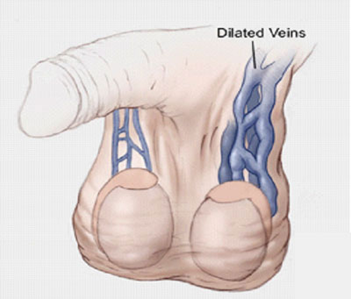
Definition
Dilated & tortuous veins of pampaniform plexus of spermatic cord found in about 15% of male adolescents with a marked left sided predominance

Slide 37
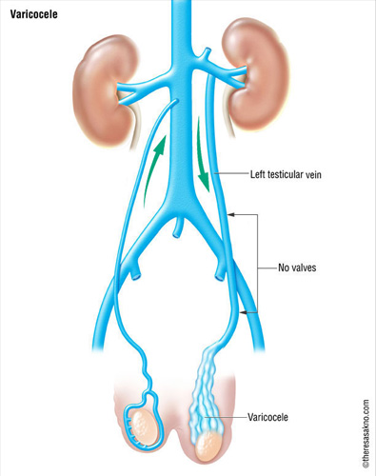
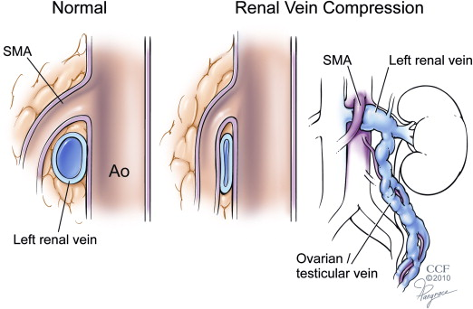
Etiology

Slide 38
Etiology
Responsible factors
8-10 cm longer left testicular Vv. → increased hydrostatic pressure in upright position
Entry of left testicular Vv into renal vein at 90⁰
“Nutcraker phenomenon” due to passage of left testicular vein between SMA & Aorta
Congenital absence of valve in left vein in 40%
Intrinsic ectasia of plexus due to cremaster atrophy
Loaded left colon

Slide 39
Pathophysiology of testicular changes
Adverse effects on spermatogenesis –
Reflux of renal and adrenal metabolites
Hyperthermia
Hypoxia
Local testicular hormonal imbalance
Intra testicular hyper perfusion injury
Increased oxidative stress

Slide 40
Clinical features (Symptoms)
Asymptomatic - detected during medical examination or evaluation of infertile male
Constant dragging pain in Testis aggravated by standing & relieved by lying down
Impaired sperm quality
Cosmetic attention
Swelling in scrotum
Failure of affected testis to grow

Slide 41
Clinical features (signs)
Examine in warm room, standing & lying position, with or without valsulva maneuver
Painless compressible mass with feeling of “Bag of worms”
Small sized Testis on affected side

Slide 42
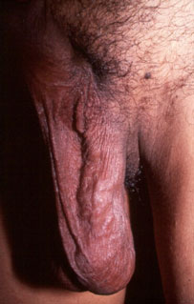
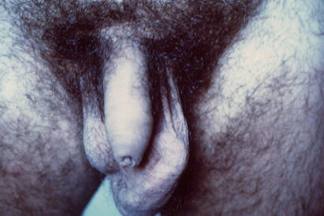

Slide 43
Grades of Varicocele
Grade I – Palpable only during valsulva maneuver
Grade II – Palpable without Valsulva in standing upright position
Grade III – Visible through scrotal skin
Subclinical – detected during USG

Slide 44
Investigation
Doppler stethoscope (5.3 MHz probe) -audible rush of blood on valsulva
Colour Doppler –detects Sub Clinical Varicocele also
Ultra sound of abdomen
Semen examination

Slide 45
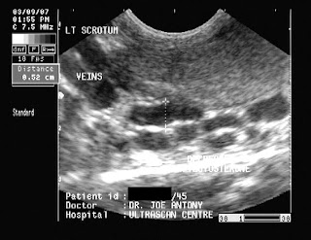
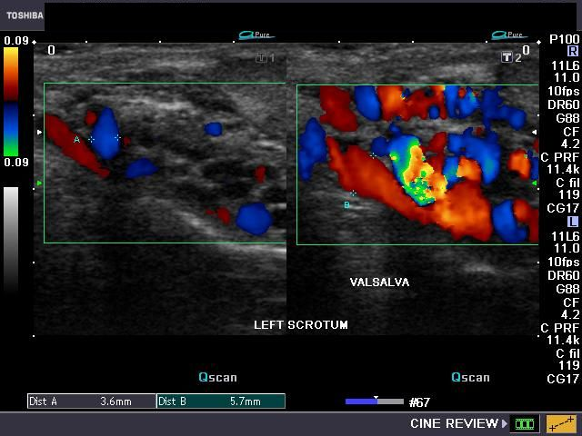
USG & Colour Doppler

Slide 46
Treatment
Expectant treatment – in adolescent males who are asymptomatic with normal size of testis

Slide 47
Treatment alteratives
(Obliteration of internal spermatic veins)
Scrotal approach
Inguinal approach (modified Ivanissevich)
Retroperitoneal approach (Palomo’s)
Sub inguinal approach
Laparoscopic approach
Per-cutaneous embolization – through trans femoral/ trans jugular access (Detachable balloons or steel coils are used)
Micro Surgery
Antigrade scrotal sclerotherapy (ASS)

Slide 48
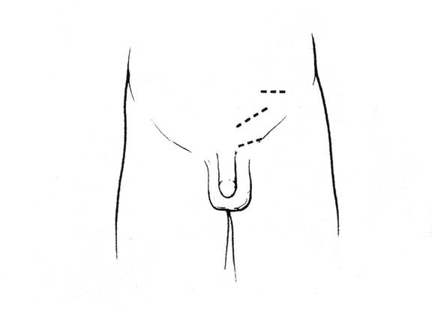
Incisions

Slide 49
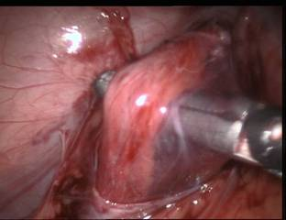
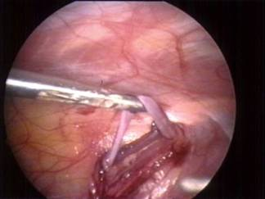
Laparoscopic approach

Slide 50
Complications of treatment
Hydrocele formation – due to ligation of lymphatics
Recurrence
Testicular infarction
Migration of coil to pulmonary artery – usually not fatal
Infection & haemorrhage

Slide 51
Complication of untreated varicocele
Male infertility
Testicular atrophy

Slide 52
NEPHROLITHIASIS
INDEX
INTRODUCTION
2) ETIOLOGY
3) TYPES OF RENAL CALCULI
4) EFFECTS OF STONES
5) CLINICAL FEATURES
6) SPECIAL INVESTIGATIONS
7) TREATMENT
8) GENERAL MEASURES

Slide 53
Renal stone or calculus or Lithiasis is one of the most common diseases of the urinary tract.
Occurs more frequently in men than in women and
in whites than in blacks.
Rare in children. It shows a familial predisposition.
Urinary calculus is a stone - like body composed of urinary salts bound together by a colloid matrix of organic materials.
It consists of a nucleus around which concentric layers of urinary salts are deposited..

Slide 54
ETIOLOGY HYPEREXCRETION OF RELATIVELY INSOLUBLE URINARY CONSTITUENTS
Oxalate – Though oxalate is the major component of 70% of all renal stones, yet hyperoxaluria as a cause of formation of such stone is relatively rare. Cabbage, rhubarb, spinach, tomatoes, black tea and cocoa contain large amount of oxalate. Ingestion of excessive amounts of ascorbic acid and orange juice also increase urinary oxalate excretion.
2. Calcium - On regular diets normal urinary excretion of calcium ranges between 200 mg to 300 mg per day. The major calcium in foods are in milk and cheese. Milk and dietary protein also cause increased absorption of calcium from the gut.
3. Uric acid - Many patients with gout form uric acid calculi particularly when under treatment. If the urine is made alkaline and dilute while treating this disease chance of uric acid stone formation is less

Slide 55
4. Cystine –Cystinuria is an herditary disease which is more common in infants and children. Only a small percentage of patients with Cystinuria form stones.
5. Drug induced stones –In rare cases, the long term use of magnesium trisilicate in the treatment of peptic ulcer has produced radio opaque silicon stones.

Slide 56
PHYSICAL CHANGES IN THE URINE –
1. Urinary pH - The mean urinary pH is 5.85. It is influenced by diet and medicines. If the urine becomes infected with urea splitting bacteria e.g. calcium phosphate.
2. Colloid content - As mentioned above it has long been claimed that the colloids in the urine allow the crystalloids to be held in a supersatured state.
3. Decreased concentration of crystalloids - This may be due to low fluid intake, excessive water losses in febric disease and in hot climates, due to excessive perspiration or due to excessive water loss from vomiting and diarrhea.
4 Urinary magnesium calcium ratio - This probably has notable influence on stone formation Acetazolamide (Diamox) causes hypocalcaemia and a decrease in the ratio

Slide 57
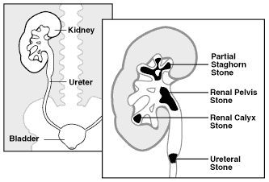
LOCATION OF STONES IN KIDNEY

Slide 58
Types of renal calculi
Primary Stones
Are those which appear in apparently healthy urinary tract without any antecedent inflammation. These stones are usually formed in acid urine.
Usually consist of calcium oxalate uric acid, urates, Cystine, xanthine or calcium carbonate.
Secondary Stones
Are usually formed as the result of inflammation. The urine is usually alkaline as urea splitting organism are most often the causative organisms.
Secondary stones are mostly composed of calcium
Ammonium-magnesium phosphate
(the so-called triple phosphates).

Slide 59
PRIMARY STONES
1. Oxalate calculus (calcium oxalate) - This type of stone is usually single and it extremely hard. It is dark in color due to staining with altered blood precipitated on its surface.
2. Uric acid and urate calculi - Pure uric acid calculi are rate and are not visible in X-ray (not radio opaque). These stones usually occur in multiples and so are typically faceted. The stones are of moderate hardness.
In children, stones of ammonium and sodium urate are sometimes found. These stoneware yellow, soft and friable.
3. Cystine calculi - These stones usually appear in patients with cystinuria Cystinuria sometimes occurs in young girls. Cystine is an aminoacid rich in sulphur. Cystine calculi usually occur in multiple are soft and yellow or pink in color.
4. Xanthine calculi - These are extremely rate smooth round and brick red in colour.
5. Indigo calculi -

Slide 60
SECONDRY STONES
1. Phosphate calculus –Majority of these stones are composed of calcium phosphate, though few are composed of ammonium magnesium phosphate 'triple phosphate' smooth, soft and friable.
It is usually dirty white in colour.
This type of calculus usually occurs in infected urine. Urine is often alkaline. Such stone enlarges rapidly and gradually fills up pelvic.

Slide 61
EFFECTS OF STONE
The size and position of the stone usually govern the development of secondary pathologic changes in the urinary trace.
A. SAME KIDNEY –
1. Obstruction
2. Infection
B OPPOSITE KIDNEY
1. Compensatory hypertrophy
2. Stone formation may be bilateral
3. Infection
4. Calculus anuria

Slide 62
CLINICAL FEATURES
Symptoms - Symptom wise cases can be divided into 4 groups :-
1. Quiescent calculus – A few stones, particularly the phosphate stones, may lie dormant for quite a long period.
These stone are also discovered due to symptoms of Urinary Infection
2. Pain - Plain is the leading symptom of renal calculus in majority of cases (80%). Three types of pain .
a) Fixed renal pain
b) Ureteric colic
c) Referred pain
3. Hydronephrosis

Slide 63
PHYSICAL SIGNS
PHYSICAL SIGNS
In majority of cases characteristic physical signs are not present. The signs which may be present and should be looked for are :
(i) Tenderness
(ii) Muscle rigidity over the kidney may be found in a few cases.

Slide 64
(iii) Swelling - When there is Hydronephrosis or pyonephrosis associated with renal calculus, a swelling may be felt in the flank.
The characteristic of a renal swelling are :-
(a) Oval or reniform in shape
(b) Swelling is almost fixed and cannot be moved.
(c) A kidney lump is ballot able.

Slide 65
SPECIAL INVESTIGATIONS
SPECIAL INVESTIGATIONS
Blood examination –
Hardly reveals any specific abnormality, increased white blood cell associated with infection. Anemia may be found, blood urea, creatinine.
2. Urinalysis -
(i) Physical examination
Show smoky urine due to slight haematuria or pale scent due to presence of pus.
(ii) Chemical examination
Show presence of protein due to haematuria and blood in the urine. If pH of the urine is higher than 7.6, presence of urea-splitting organism is assured.
(iii) Microscopic examination of urine
Show R.B.C. pus cells and casts. Different crystals may be seen in the sediment to givea clue as to the type of stone present. Uric acid of glacial acetic acid, which lowers the urinary pH to about 4.
(iv) Bacteriological examination of urine
Highly important including culture and sensitivity tests.
(v) Renal function tests
Always be performed in calculus cases. The PSP may be normal even in presence of bilateral stag horn calculi.

Slide 66
3.Radiography
A) STRAIGHT X-RAY - Before taking straight X-ray for KUB region (both kidneys, ureters and bladder), the bowels must be made empty by giving laxative.
B) Excretory Urogram
4 Ultrasonography –
Helpful to distinguish between opaque and non-opaque stones. It is also of value in locating the stones for treatment with extra corporeal shock wave therapy.
5 Computed topography –
Particularly helpful in the diagnosis of non-opaque stones.
6 Renal Scan
7 Instrumental examination :- Cystoscopy
8 Examination of the stone

Slide 67
TREATMENT
ESWL (Extra corporeal Shock Wave Lithotripsy)
In this technique the stone is removed with shock wave without the need for instrumental penetration of the body. The stone in the kidney is fragmented by repeated shock waves which are focused towards the kidney stone. The fragments are made so small that they are automatically passed through the urine. In some instances a ureteroscope may be required for the passage of fragments.
This method is gradually replacing operative methods of removal of renal calculi.

Slide 68
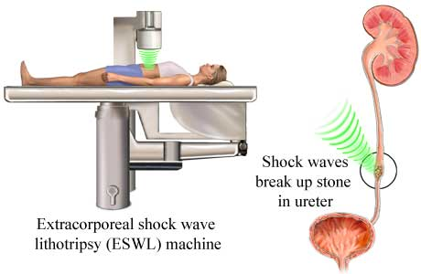

Slide 69
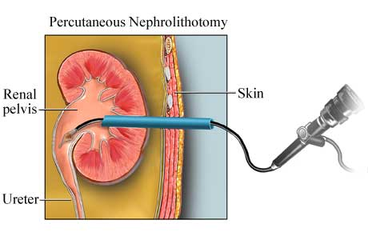
Nephrectomy

Slide 70
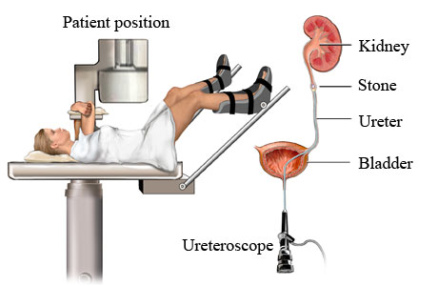
Ureteroscopy (URS)

Slide 71
Open Surgery
Pyelolithotomy
Nephrolithotomy
Partial nephrectomy

Slide 72
General measures
The general measures or advises which should be given to the patient regardless of the type of stone are -
(a) Fluid intake should be high at all times.
Fluids should be taken at bed time so that nocturia will occur.
This will prevent dehydration.
(b) Avoidance of milk, cheese and great deal of calcium should be advised.
If renal function is satisfactory sodium cellulose phosphate 5g. T.D.S. with
meals should be prescribed to reduce calcium absorption.
(c) Urine should be kept acid all the time. Alkalies should be prohibited
or used in less quantities in those patients who are suffering from peptic
ulcer.
(d) Vitamin D should be stopped or used in very low quantity

Slide 73
C O N S E R V A T I V E M E A S U R E S
Not all patients with renal stones require surgery.
(i) When the stones are sufficiently small, these can be naturally eliminated and
expectant policy is best adopted in these cases.
(ii) In the elderly, poor risk patients a curalliform stone is best left alone unless it
causes significant symptoms.
(iii) Chemical dissolution of renal stones requires indwelling urethral
catheters for constant through and through irrigation with Renacidin
or with G solution. Sometimes stone fragments occlude the ureteral
catheters and cause acute obstruction.

Slide 74
P r e v e n t i o n
As the patients who have already undergone treatment for renal stones should be managed prophylactic ally in an attempt to prevent recurrence. With more knowledge of stone formation, responsibilities lie on the surgeons to prevents further stone formation and cannot be left solely to God to prevent recurrence or to fully cure the patient.
A. False recurrence, which means a tiny stone was overlooked at the time of operation,
B. True recurrence - A patient with renal stone is usually liable to produce further stone subsequently. So attempt should always be made to prevent such recurrence

Slide 75
RENAL TRAUMA
Normally, the kidneys are protected by the rib cage and musculature of the back posteriorly and by a cushion of abdominal wall and viscera anteriorly.
With traumatic injury, the kidney can be thrust against the lower
ribs, resulting in contusion and rupture.

Slide 76
Renal trauma may be classified by the mechanism of injury:
blunt or
penetrating.
Blunt renal trauma is classified into one of four groups

Slide 77
Contusion: bruises or hemorrhages under the renal capsule; and collecting system intact
Minor laceration: superficial disruption of the cortex; renal medulla and collecting system are not involved
Major laceration: parenchymal disruption extending into cortex and medulla, possibly involving the collecting system
Vascular injury: tears of renal artery or vein

Slide 78
The kidneys receive half of the blood flow from the abdominal aorta; therefore, even a fairly small renal laceration can produce massive bleeding. About 70% of patients are in shock when admitted to the hospital

Slide 79
Clinical manifestations
pain, renal colic
hematuria,
mass or swelling in the flank,
ecchymoses, and lacerations
wounds of the lateral abdomen and flank.
Signs and symptoms of hypovolemia and shock are likely with significant hemorrhage.

Slide 80
URETERAL TRAUMA
Penetrating trauma and unintentional injury during surgery are the major causes of trauma to the ureters.
Gunshot wounds account for 95% of ureteral injuries, which may range from contusions to complete transection.
If the ureteral trauma is not detected and urine leakage continues, fistulas are likely to develop.
Intravenous urography detects 90% of ureteral injuries
Surgical repair with placement of stents (to
divert urine away from the anastomoses) is usually necessary

Slide 81
BLADDER TRAUMA
Injury to the bladder may occur with pelvic fractures and multiple trauma or from a blow to the lower abdomen when the bladder is full.
Blunt trauma may result in contusion evident as an ecchymosis.
Complications from these injuries include hemorrhage,
shock,
sepsis, and
extravasation of blood into the tissues, which must be treated promptly

Slide 82
URETHRAL TRAUMA
The goals of management in patients with genitourinary trauma are to control :
hemorrhage,
pain,
Infection
to preserve and restore renal function;
and to maintain urinary drainage.

Slide 83
The patient is monitored for oliguria and signs of hemorrhagic shock because a pedicle injury or shattered kidney can lead to rapid exsanguination

Slide 84
SURGICAL MANAGEMENT
In renal trauma, any sudden change in the patient’s condition may indicate hemorrhage and requires surgical intervention.
NURSING ALERT Vital signs, urine output, and level of consciousness are monitored to detect bleeding and shock. Opioid analgesia is avoided because this may mask accompanying abdominal symptoms.

Slide 85
NURSING ALERT The patient is prepared for immediate surgery in cases of increasing pulse rate, hypotension, and impending shock.
Early postoperative complications (within 6 months) include
rebleeding,
perinephritic abscess formation,
sepsis,
urine extravasation,
and fistula formation.

Slide 86
Other complications include
stone formation,
infection,
cysts,
vascular aneurysms,
and loss of renal function.
Hypertension can be a complication of any renal surgery but usually is a late complication of renal injury

Slide 87
Nursing Management
assessed frequently during the first few days after injury to detect flank and abdominal pain, muscle spasm, and swelling over the flank.
patients can be instructed about care of the incision and the importance of an adequate fluid intake.
instructions about changes that should be reported to the physician, such as fever, hematuria, flank pain, or any signs and symptoms of decreasing kidney function, are provided

Slide 88
Follow-up nursing care includes monitoring the blood pressure to detect hypertension and advising the patient to restrict activities for about 1 month.
The patient should be advised to schedule periodic follow-up assessments of renal function.
If a nephrectomy was necessary, the patient is advised to wear medical identification.

Slide 89
HYDRONEPHROSIS
Hydronephrosis is dilation of the renal pelvis and calyces of one or both kidneys due to an obstruction.

Slide 90
Pathophysiology
Obstruction to the normal flow of urine causes the urine to back up, resulting in increased pressure in the kidney.
If the obstruction is in the urethra or the bladder, the back pressure affects both kidneys,
but if the obstruction is in one of the ureters because of a stone or kink, only one kidney is damaged.

Slide 91
Causes of obstruction
Renal stones
Tumors
In older men– urethral obstruction, BPH
pregnancy because of the enlarged uterus.

Slide 92
as the urine accumulates in the renal pelvis, it distends the pelvis and its calyces.
In time, atrophy of the kidney results.
As one kidney undergoes gradual destruction, the other kidney gradually enlarges (compensatory hypertrophy).
Ultimately, renal function is impaired.

Slide 93
Clinical Manifestations
The patient may not have symptoms if the onset is gradual.
Acute obstruction may produce aching in the flank and back.
If infection is present, dysuria, chills, fever, tenderness, and pyuria may occur.
Hematuria and pyuria may be present.
If both kidneysare affected, signs and symptoms of chronic renal failure may develop.

Slide 94
Medical Management
The goals are to identify and correct the cause of the obstruction,
to treat infection,
to restore and conserve renal function.
The patient is prepared for surgical removal of obstructive lesions
If one kidney
is severely damaged and its function is destroyed, nephrectomy
(removal of the kidney) may be performed.

Slide 96
Renal Failure
Renal failure results when the kidneys cannot remove the body’s metabolic wastes or perform their regulatory functions.
The substances normally eliminated in the urine accumulate in the body fluids.
leading to a disruption in endocrine and metabolic functions as well as fluid, electrolyte, and acid–base disturbances.

Slide 97
ACUTE RENAL FAILURE
Two types of renal failure should be distinguished:
Failure of kidneys alone, with other systems functioning well.
Multiorgan failure.
RF in critical care cases is associate with multiorgan failure.

Slide 98
Definitions.
Acute renal failure– the sudden development of renal insufficiency, leading to uramia and loss of electrolyte balance contral in a previously well patient.
Oliguria– A urine volume of less than 0.5ml/kg/hour.
Pre-renal acute renal failure ( reversible renal hypoperfusion).– Arises as a result of renal hypoperfusion/hypovolemia/ low cardiac output/low BP

Slide 99
Def…
Non-oliguric acute renal failure– Acute tubular necrosis, where there is uraemia and loss of electrolyte control though no coexisting oliguria.

Slide 100
CATEGORIES OF ACUTE RENAL FAILURE ( Causes)
Classified into three
Pre-renal
Renal (intrinsic)
Post-renal

Slide 101
Pre-renal
CAUSE | EXAMPLE
Hypovolemic causes | Hypovolemia, burns, GI loss,renal loss, third spaces loss e.g sepsis,pancreatitis
Cardiogenic causes | Arrhythmias, heart failure, valvular dysfunction
Obstructive causes | Pericardial tamponade, pulmonary embolism

Slide 102
Intrinsic causes
Cause | Example
Acute tubular necrosis | Unreleaved pre-renal causes, acute hemorrhage, haemoglobin, pancreatitis,septic abortion, eclampsia, burns, nephrotoxins, SLE
Cortical necrosis | Snake venom, nephrotic syndrome, renal artery occlusion, DIC, acute pyelonephritis, glomerulonephritis,
Acute interstitial nephritis | Penicillins, cephalosporins, diuretics, rifampicin, NSAIDs

Slide 103
Post-renal
Cause | example
Intra-ureteral | Calculi, papillary necrosis, crystals, tumors, blood clot
Extra-ureteral | Retroperitoneal fibrosis, tumor, aneurysm
Bladder obstruction | Prostatic hypertrophy, bladder tumor, blood clot, calculi, functional neuropathy
Urethral obstruction | Stricture, meatal stenosis, phimosis

Slide 104
PHASES OF ACUTE RENAL FAILURE
There are four clinical phases of ARF:
initiation,
oliguria,
diuresis,
recovery.

Slide 105
Initiation-- The initiation period begins with the initial insult and ends when oliguria develops.
Oliguria– is accompanied by a rise in the serum concentration of substances usually excreted by the kidneys (urea, creatinine, uric acid, organic acids, and the intracellular cations [potassium and magnesium]).
uremicsymptoms first appear and life-threatening conditions such as hyperkalemia develop.

Slide 106
Diuresis-- the third phase, the patient experiences gradually increasing urine output, which signals that glomerular filtration has started to recover.
Lab values stop rising.
Uraemic symptoms still present.
Still needs expart medical and nursing care.

Slide 107
Recovery
The recovery period signals the improvement of renal function and may take 3 to 12 months.
Laboratory values return to the patient’s normal level.
Although a permanent 1% to 3% reduction in the GFR is common, it is not clinically significant

Slide 108
Clinical manifestations
The patient may appear critically ill and lethargic,
with persistent nausea, vomiting, and diarrhea.
skin and mucous membranes are dry from dehydration
breath may have the odor of urine (uremic fetor).
Central nervous system signs and symptoms include
drowsiness,
headache,
muscle twitching,
and seizures.

Slide 109
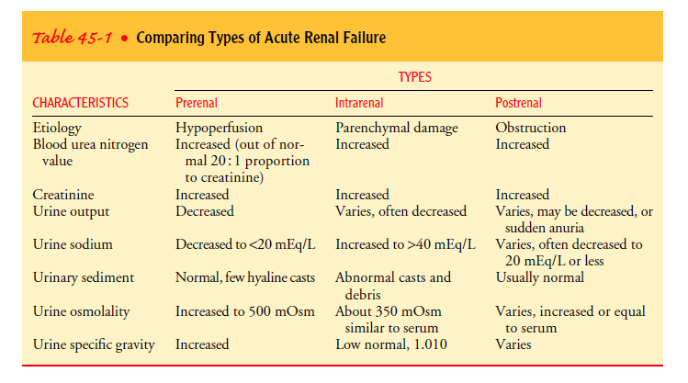

Slide 110
Assessment and Diagnnosis
Sample | Tests
Urine | Urinalysis- microscopy, ulture sensitivity. Electrolytes, osmolality, urea, creatinine clearance, myoglobinuria
Blood | Full hemogram, coagulation screen, electrolytes– urea, creatinine, calcium, phosphate, magnesium, glucose ABG,s LFT’s creatinine kinase, autoantibodies
Radiological | AB & chest xray, renal ultrsound, urography, isotope renography, CT scan
Others | 12-lead ECG Renal biopsy

Slide 111
Change in kidney contour
Increased BUN and creatinine levels ( azotemia)
Hyperkalemia
Metabolic acidosis
Calcium and phosphorous abnomalities
Anemia

Slide 112
Priorities of care
Airway. The patients LOC may deteriorate in the presence of uremia.
Breathing. Can be affected by pulmonary oedema from fluid overload.
Circulation. ECG and BP monitoring shoud be standard.

Slide 113
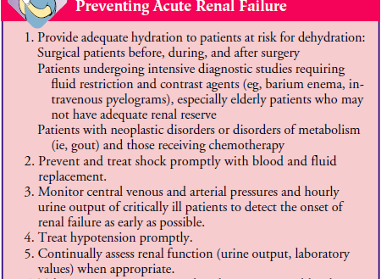

Slide 114
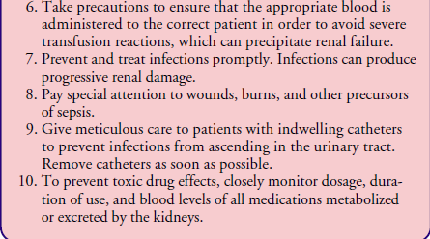

Slide 115

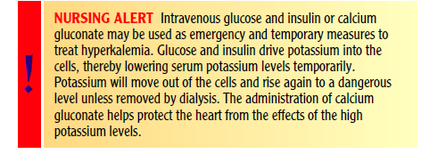

Slide 116
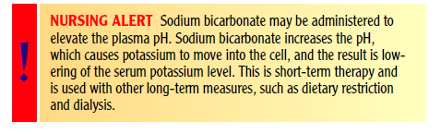

Slide 117
PHARMACOLOGIC THERAPY
elevated potassium levels may be reduced by administering cation-exchange resins (sodium polystyrene sulfonate [Kayexalate]).
Sorbitol is often administered in combination with Kayexalate to induce a diarrhea-type effect (it induces water loss in the GI tract).
Because many medications are eliminated through the kidneys, medication dosages must be reduced when a patient has ARF.

Slide 118
Diuretic agents are often used to control fluid volume, but they have not been shown to hasten the recovery from ARF.
Low-dose dopamine (1 to 3 g/kg) is often used to dilate the renal arteries through stimulation of dopaminergic receptors;

Slide 119
Nursing Management
In addition to directing attention to the patient’s primary disorder:
monitors for complications,
participates in emergency
treatment of fluid and electrolyte imbalances,

Slide 120
assesses progress and response to treatment,
provides physical and emotional support.
keeps family members informed about the patient’s condition, helps them understand the treatments,and provides psychological support.
the nurse mustcontinue to include in the plan of care those nursing measures indicatedfor the primary disorder (eg, burns, shock, trauma, obstruction of the urinary tract).

Slide 121
MONITORING FLUID AND ELECTROLYTE BALANCE
Parenteral fluids, all oral intake, and all medications are screened carefully to ensure that hidden sources of potassium are not inadvertently administered or consumed.
The patient’s cardiac function and musculoskeletal status are monitored closely for signs of hyperkalemia.
monitors fluid status
Indicators of deteriorating fluid and electrolyte status are reportedimmediately to the physician, and preparation is made foremergency treatment.

Slide 122
REDUCING METABOLIC RATE
To reduce catabolism and the subsequent release of potassium and accumulation of endogenous waste products (urea and creatinine).
Bed rest
Prevent and treat promptly fever and infection.

Slide 123
Promoting pulmonary function
Preventing infection
Providing skin care
Providing support

Slide 124
NUTRITIONAL THERAPY
ARF causes severe nutritional imbalances
Dietary proteins are limited to about 1 g/kg during the oliguric phase.
Caloric requirements are met with high-carbohydrate meals because carbohydrates have a proteinsparing effect.
Foods and fluids containing potassium or phosphorus
(bananas, citrus fruits and juices, coffee) are restricted.

Slide 125
CHRONIC RENAL FAILURE (END-STAGE RENAL DISEASE)
Chronic renal failure, or ESRD, is a progressive, irreversible deterioration in renal function in which the body’s ability to maintain metabolic and fluid and electrolyte balance fails, resulting in uremia or azotemia.

Slide 126
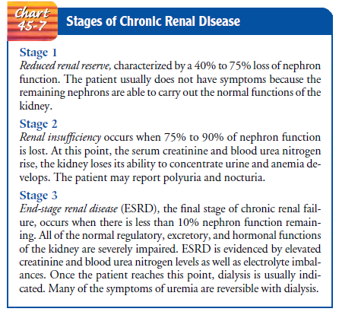

Slide 127
ESRD causes
may be caused by systemic diseases, such as diabetes mellitus (leading cause);
hypertension;
chronic glomerulonephritis;
pyelonephritis;
obstruction of the urinary tract;
hereditary lesions,as in polycystic kidney disease;
vascular disorders; infections;
medications; or toxic agents.

Slide 128
Environmental and occupational agents that have been implicated in chronic renal failure include
lead,
cadmium,
mercury,
chromium.

Slide 129
Pathophysiology
As renal function declines, the end products of protein metabolism (which are normally excreted in urine) accumulate in the blood.
Uremia develops and adversely affects every system in the body.

Slide 130
Clinical Manifestations
CARDIOVASCULAR MANIFESTATIONS
Hypertension-- activation of the renin–angiotensin–aldosterone system
Heart failure and pulmonary edema (due to fluid overload).
Pericarditis-- uremic toxins
Cardiovascular disease is the predominant cause of death in patients with ESRD.

Slide 131
DERMATOLOGIC SYMPTOMS
Severe itching (pruritus) is common.
Uremic frost, the deposit of urea crystals on the skin,
Other systemic manifestations include:
anorexia, nausea,
vomiting, and hiccups.
Neurologic changes, including altered levels of consciousness,
inability to concentrate,
Muscle twitching, and seizures,

Slide 132
Your texRENAL REPLACEMENT THERAPYt here

Slide 133
Kidney Functions
Excretory
Regulatory
Endocrine

Slide 134
Excretory Functions
Removal of waste products– nitrogenous
Urea– breakdown of protein in diet
Creatinine– skeletal/ muscle breakdown

Slide 135
Regulatory
Fluid balance
Electrolyte balance– Na⁺ K⁺ Ca²⁺ PO₄³⁻ Mg
Acid/ base balance; prevents metabolic acidosis.

Slide 136
Endocrine
Production of renin– contrals BP affects Na+ reabsorption and fluid balance
Erythropoietin

Slide 137
Renal replacement therapy
These are therapies initiated in patients with end stage renal disease (ESRD).
They take over the regulatory and excretory functions of the kidneys but not the endocrine functions of the kidneys.

Slide 138
HEMODIALYSIS
Components of dialysis
Transport mechanism.
Dialyzer ( semipermeable membrane).
Dialysate
Other essentials: vascular access & heparinisation

Slide 139
Indications of Hemodialysis
Clinical indications: in ESRD pts:
High plasma creatinine
Low GFR < 15ml/min
Uremic symptoms
Fluid overload
hyperkalemia

Slide 140
Indications for acute dialysis
Hyperkalemia
Metabolic acidosis
Fluid oveload
Neuropathies
Pericarditis, encephalopathy
Poisoning
hyperuricaemia

Slide 141
Principles of Dialysis: Transport mechanisms
Necessary to move fluid and solutes through the semipermeable membrane.
Principles/ mechanisms
Osmosis
Diffusion
Filtration
Ultrafiltration

Slide 142
Osmosis
Movement of FLUID across a semipermeable membrane from an area of LOWER solute concentration to an area of HIGHER solute concentration

Slide 143
DIFFUSION
Movement of DISSOLVED PARTICLES ( SOLUTES) across a semipermeable membrane from an area of HIGHER solute concentration to an area of LOWER solute concentration
Removes waste products from blood i.e BUN and creatinine

Slide 144
FILTRATION
Process of passing fluid through a filter or a semipermeable membrane.
Filtration is controlled by hydrostatic prssure.
Fluid always moves from an area of higher pressure to an area of lower pressure.
Regulates fluid balance in the blood

Slide 145
ULTRAFILTRATION
Convective flow of water and dissolved solutes down a concentration gradient.
Refers to controlled fluid removal by manipulation of hydrostatic pressure.
Ultrafiltration uses both negative and positive pressure

Slide 146
Ultra…
The pressure can be due to osmotic or hydrostatic forces.
Positive pressure= pressure exerted by blood flowing through the dialyzer. Results from blood being pushed by blood pump.
Negative pressure= pressure generated by dialysate effluent pump.
Pulls excess fluid from blood compartment to dialysate compartment to drain.

Slide 147
Constituents of Hemodialysis
Hemodialysis machine
Dialyser (artificial kidney)
Dialysate (treated water, HCO-3 & concentrate)
Other essentials– venous access, heparinasation

Slide 148
Dialyzer: artificial kidney
Consists
A rigid shell containing numerous parallel sheets(plates) or hollow fibers ( capillaries) or the dialysis membrane
4 ports: 2 for blood, 2 for dialysate.
NB: blood and dialysate flow in different compartments( do not mix) and in different directions.
The hollow fibers/ numerous plates increase the surface area for contact btwn the blood and dialysate

Slide 149
1. hollow fibers– blood flows in capillaries
2. plates: blood and dialysate alternate btwn plates.
Hollow fibers
Advantage: easy to prime, reuse.
Disad’: clot easily, retain sterilant

Slide 150
Contains two separate containers which facilitates countercurrent flow

Slide 151
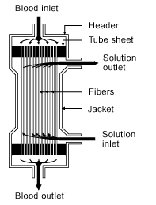

Slide 152
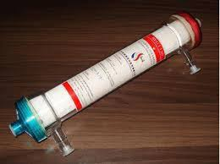
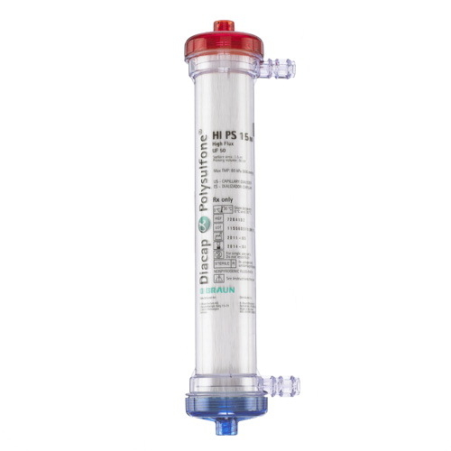

Slide 153
Properties of an ideal dialyser
Great clearance for small and medium size molecules.
Adequate ultrafiltration.
Negligible loss of amino-acids and proteins.
Non-toxic in composition.
Biocompatible- minimal activation of compliment
Low cost, reusable, reliable

Slide 154
Dialysis membrane reactions
Type 1 : Anaphylaxis– cough urticaria, hypotension, wheezing shock
Type 2: milder, more common – chest and back pain

Slide 155
Dialysis machine
At its simples– is an extracorporeal circuit that pumps blood and dialysate through a dialyser.
It is made more complex by addition of safety devices including pump controllers, pressure and flow monitors, air leak detectors, ability to titrate/ change composition of dialysate etc.

Slide 156
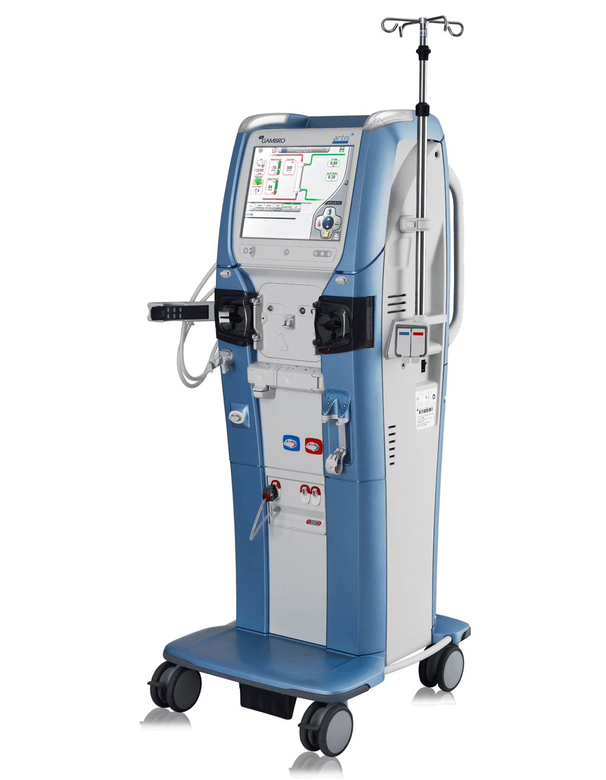
Key features:
Blood pump, bubble trap, heparine delivery
Pressure monitors, blood leak monitors, temperature monitors, conductivity/ composition of dialyste

Slide 157
Dialysate
Refers to dialysis solution
Constituents
Solute (solute concentrates)
Buffers (for correction of acid base imbalance)
Treated water (titrated to patients prescription)

Slide 158
Priming
Procedure involving flushing the complete extracoporeal circuit with saline, preparing machine settings– before fixing the patient onto the dialysis cycle.
Role
Ascertain functioning of the dialysis machine
Ascertain integrity of the circuit (no leaks)
Remove air bubbles
Removes sterilants and preservatives from the circuit and dialyser etc

Slide 159
Buffers
Acetate or Bicarbonate
Bicarbonate preferred– because o high biocompatibility (physiologic buffer).
Superior buffer in normalizing acidosis without risk of alkalosis

Slide 160
Lactate based solutions (acetate)
Must be converted in the liver to bicarbonate under normal conditions
Disadvantages
Non-physiologic ph 5.4
Powerful peripheral vasodilator
Can worsen acidemia in patients with hypoxia, liver impairment, pre-existing lactic acidemia

Slide 161
Vascular access
Temporary vascular access. Used when required for <3 wks.
Subclavian vein– least preferred
High risk of hemi and pneumothorax.
Central venous stenosis
Internal jugular vein(R)– primary site of choice
1. easy to insert
2. low risk of infection

Slide 162
Femoral vein
Ideal for bed bound/ immobile
Ideal for acute hemodialysis
May be used for several weeks
Risks – hematoma, high risk of infections, thrombosis etc

Slide 163
Permanent vascular access
Fistula (arteriovenous fistula):
formed by anastomosing an artery and a vein subcutaneously usually in the forearm
Matures over several months by venous dilatation and thickening of veins wall(arterialisation)– thus must be constructed well in advance of need
Post op teachings
press on small ball in intervals, after maturation X BP, X lifting heavy loads & should always be pulsating.

Slide 164
AV fistula
Risks
Aneurysms
Steal syndrome
Advantages:
lower infection rates(no foreign body material involved in their formation).
higher blood flow rates
more effective dialysis.
lower incidence of thrombosis
better access patency and survival

Slide 165
AV graft
Risks
High risk to develop narrowing
Narrowing often leads to clotting and thrombosis
High risk for infection

Slide 166
Locations for AVF
Oder of preference
Radio-cephalic (wrist)
Brachio-cephalic (elbow)
Brachiol basilic transposition

Slide 167
Session timing
First dialysis session: should not be too long. 2hrs optimum. Should not remove uraemic toxins >30%
Due to complications arising with rapid clearance of uraemia toxins ( dialysis disequlibrium syndrome)
2nd session should be 3hrs and subsequent 3-4 hrs

Slide 168
Complications of dialysis
Hypotension
Cramps
Chest pains
Air embolism
Hemolysis
Nausea, vomiting and headaches
Dialysis reaction
Dialysis disequilibrium syndrome
Blood clotting
Exanguination of blood

Slide 169
Peritoneal Dialysis
Peritoneal access is obtained by inserting a catheter through the anterior wall
Technique for catheter placement varies
Usually done via surgery

Slide 170
Peritoneal Dialysis
After catheter inserted, skin is cleaned with antiseptic solution and sterile dressing applied
Connected to sterile tubing system
Secured to abdomen with tape
Catheter irrigated immediately

Slide 171
Peritoneal Dialysis
Waiting period of 7 to 14 days preferable
2 to 4 weeks after implantation, exit site should be clean, dry, and free of redness/tenderness
Once site healed patient may shower and pat dry

Slide 172
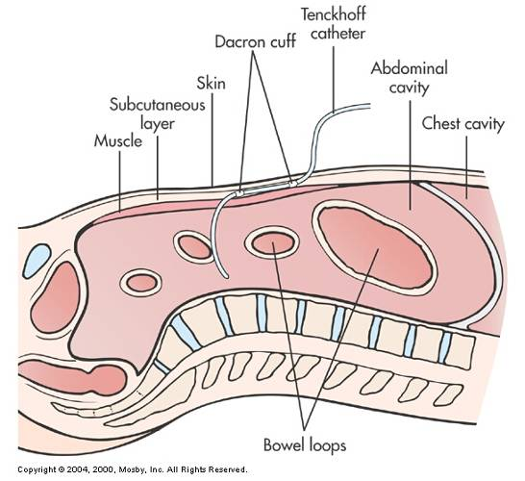
Tenckhoff Catheter
Fig. 47-8

Slide 173
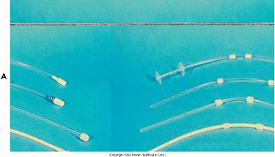
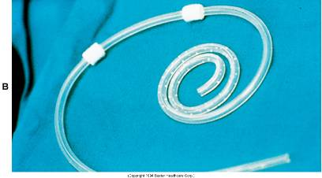
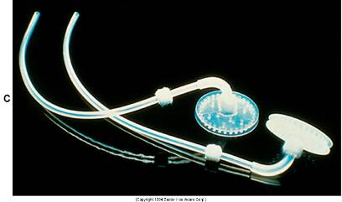
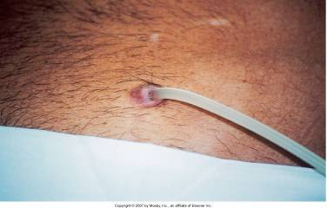
Fig. 47-9 and Fig. 47-10

Slide 174
Peritoneal Dialysis Dialysis Solutions and Cycles
Available in 1- or 2-L plastic bags with glucose concentrations of 1.5%, 2.5%, and 4.25%
Electrolyte composition similar to plasma
Solution warmed to body temperature

Slide 175
Peritoneal Dialysis Dialysis Solutions and Cycles
Three phases of PD cycle
Called an exchange
Inflow (fill)
Dwell (equilibration)
Drain

Slide 176
Peritoneal Dialysis Dialysis Solutions and Cycles
Inflow
Prescribed amount of solution infused through established catheter over about 10 minutes
After solution infused, inflow clamp closed to prevent air from entering tubing

Slide 177
Peritoneal Dialysis Dialysis Solutions and Cycles
Dwell
Diffusion and osmosis occur between patient’s blood and peritoneal cavity
Duration of time varies depending on method
The removal of excess water during peritoneal dialysis is achieved by using a hypertonic dialysate with a high dextrose concentration that creates an osmotic gradient.
Dextrose solutions of 1.5%, 2.5%, and 4.25% are available in several volumes

Slide 178
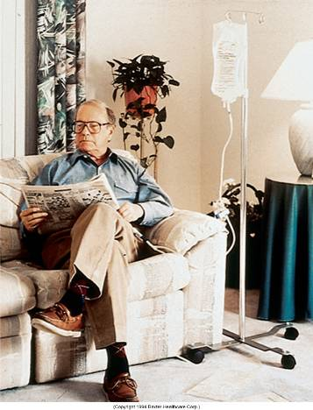
Fig. 47-12

Slide 179
Peritoneal Dialysis Dialysis Solutions and Cycles
Drain
15 to 30 minutes
May be facilitated by gently massaging abdomen or changing position

Slide 180
Peritoneal Dialysis Systems
Automated peritoneal dialysis (APD)
Cycler delivers the dialysate
Times and controls fill, dwell, and drain
Continuous ambulatory peritoneal dialysis (CAPD)
Manual exchange

Slide 181
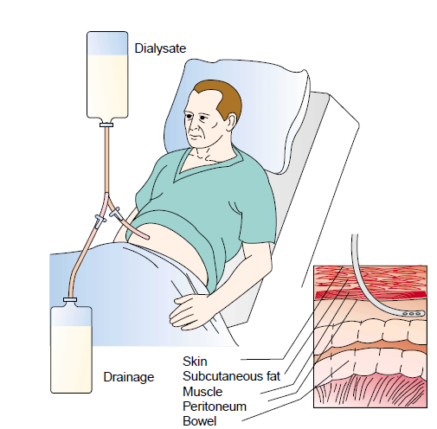

Slide 182
Peritoneal Dialysis Complications
Exit site infection
Peritonitis
Abdominal pain
Outflow problems
Hernias

Slide 183
Peritoneal Dialysis Complications
Lower back problems
Bleeding
Pulmonary complications
Protein loss

Slide 184
Peritoneal Dialysis Complications
Carbohydrate and lipid abnormalities
Encapsulating sclerosing peritonitis
Loss of ultrafiltration

Slide 185
Peritoneal Dialysis Effectiveness and Adaptation
Short training program
Independence
Ease of traveling
Fewer dietary restrictions
Greater mobility than with HD

Slide 186
Continuous Arteriovenous Hemofiltration (CAVH)
Blood is circulated through a small-volume, low-resistance filter, using the patient’s arterial pressure rather than that of the blood pump as is used in hemodialysis.
With CAVH, there is no concentration gradient, so only fluid is filtered.

Slide 187
Continuous Arteriovenous Hemodialysis (CAVHD)
offers the advantage of a concentration gradient for faster clearance of urea.
This is accomplished by the circulation of dialysate on one side of a semipermeable membrane.

Slide 188
Continuous Venovenous Hemofiltration (CVVH)
Blood from a double-lumen venous catheter is pumped (using a small blood pump) through a hemofilter and then returned to the patient through the same catheter.

Slide 189
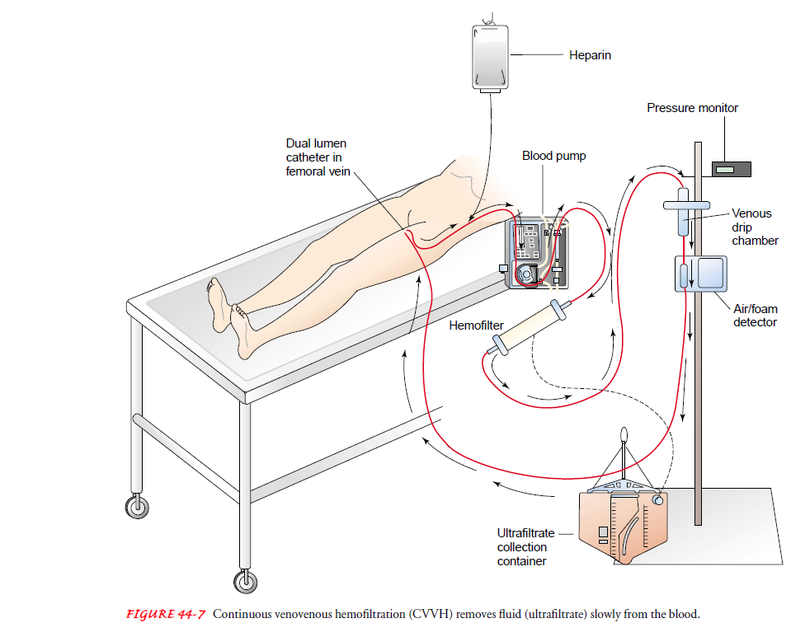

Slide 190
Continuous Venovenous Hemodialysis (CVVHD)
is similar to CVVH.
Blood is pumped from a double-lumen venous catheter through a hemofilter and returned to the patient through the same catheter.
CVVHD uses a concentration gradient to facilitate the removal of uremic toxins.

Slide 191
thankyou

Slide 192
TUBERCULOSIS OF THE URINARY TRACT
Pathophysiology
Tuberculosis of the urinary tract is caused by the organism Mycobacterium tuberculosis and is relatively rare in developed countries.
The organism usually travels from the lungs by means of the bloodstream to the kidneys.
On arrival in the kidney, the microorganism may lie dormant for years.
After the organism reaches the kidney, a low-grade inflammation and the characteristic tubercles are seen.

Slide 193
If the organism continues to multiply, the tubercles enlarge to form cavities, with eventual destruction of parenchymal tissue.
The organism spreads down the urinary tract into the bladder and may also infect the prostate, epididymis, and testicles in men.

Slide 194
Clinical Manifestations
At first, the signs and symptoms of renal tuberculosis are mild;there is usually a slight afternoon fever, weight loss, night sweats, loss of appetite, and general malaise.
Hematuria (microscopic orgross) and pyuria may be present.
Pain, dysuria, and urinary frequency, when they occur, are due to bladder involvement.

Slide 195
Assessment and Diagnostic Findings
urine specimens are obtained for culture for M. tuberculosis.
intravenous urography,
biopsy,
urine culture for acid-fast bacilli.
Recent studies have shown that the polymerase chain reaction (PCR) provides a much faster diagnosis of urinary M. tuberculosis.

Slide 196
Medical Management
The goal of treatment is to eradicate the offending organism.
Combinations of ethambutol, isoniazid, and rifampin are used to delay the emergence of resistant organisms.
Shorter-course chemotherapy (4 months) has been effective in eradicating the organism and in penetrating renal tissue.
Surgical intervention may be necessary to treat obstruction and to remove an extensively diseased kidney.

Slide 197
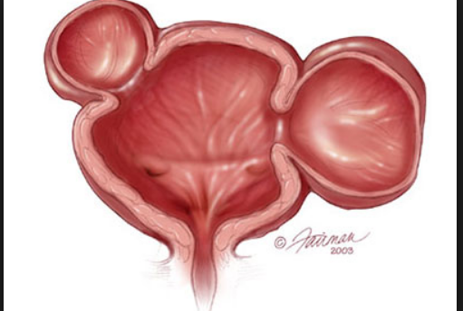
BLADDER DIVERTICULI

Slide 198
A bladder diverticulum is an pouch or sac that protrudes out of the bladder wall.
There are two types of bladder diverticulum: congenital and acquired.
Congenital means that the individual was born with this pouch; acquired means that the pouch formed from a health condition that has affected the bladder.

Slide 199
symptoms of a bladder diverticulum
Bladder diverticula are often asymptomatic, but there can be urinary related symptoms. Some of the symptoms include:
Urinary retention (inability to urinate).
Urinary tract infection.
Blood in the urine.

Slide 200
diagnosed
Bladder diverticula are often diagnosed on imaging studies like a CT scan or ultrasound.
Cystogram (x-ray test of the bladder with contrast dye).
Cystoscopy (placing a scope into the bladder via the urethra).

Slide 201
diverticulum treated
Congenital or acquired diverticula do not always require treatment, particularly if they are not associated with urinary infections, bladder stones, or urinary reflux (backward flow of urine into the kidneys). When associated with bladder tumors, recurrent infection, or urinary retention, bladder diverticula will need treatment. For patients with diverticula and urinary obstruction, treatment will include relief of the obstruction and possible removal of the diverticulum. This condition can be treated with both open and laparoscopic surgery.

Slide 202
CONDITIONS OF URETHRA
HYPOSPADIAS AND EPISPADIAS
Hypospadias and epispadias are congenital anomalies of the urethral opening.
hypospadias, the urethral opening is a groove on the underside of the penis.
epispadias, the urethral opening is on the dorsum.
These anatomic abnormalities may be repaired by various types of plastic surgery, usually when the boy is very young.

Slide 203
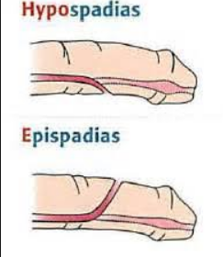

Slide 204
URETHRAL STRICTURES
A urethral stricture is a narrowing of the lumen of the urethra as a result of scar tissue and contraction.

Slide 205
Pathophysiology
Common causes of strictures are urethral injury (caused by insertion of surgical instruments during transurethral surgery, indwelling catheters, or cystoscopic procedures), straddle injuries, and injuries associated with automobile crashes, untreated gonorrheal urethritis, and congenital abnormalities.

Slide 206
Assessment and Diagnostic Findings
The patient reports that the force and volume of the urinary stream are diminished, and symptoms of urinary infection and retention occur.
Stricture causes urine to back up, resulting in cystitis, prostatitis, and pyelonephritis.

Slide 207
Prevention
An important element of prevention is to treat all urethral infections promptly.
Prolonged urethral catheter drainage should be avoided and the utmost care taken in any type of instrumentation involving the urethra, including catheterization.

Slide 208
Medical/Surgical Management
Treatment may include gradual dilation of the narrowed area or surgery (internal urethrotomy).
Surgical excision or urethroplasty may be necessary for severe cases.

Slide 209
READ ON TESTICULAR TORSION

Slide 210
Continuous Venovenous Hemofiltration (CVVH)
Blood from a double-lumen venous catheter is pumped (using a small blood pump) through a hemofilter and then returned to the patient through the same catheter.

Slide 212
Continuous Venovenous Hemodialysis (CVVHD)
is similar to CVVH.
Blood is pumped from a double-lumen venous catheter through a hemofilter and returned to the patient through the same catheter.
CVVHD uses a concentration gradient to facilitate the removal of uremic toxins.

Slide 213
Kidney Transplantation
Kidney transplantation has become the treatment of choice for most patients with ESRD.
Kidney transplants from well-matched living donors
who are related to the patient (those with compatible ABO and HLA antigens) are slightly more successful than those from cadaver donors.

Slide 214
The transplanted kidney is placed in the patient’s iliac fossa anterior to the iliac crest.
The ureter of the newly transplanted kidney is transplanted into the bladder or anastomosed to the ureter of the recipient

Slide 215
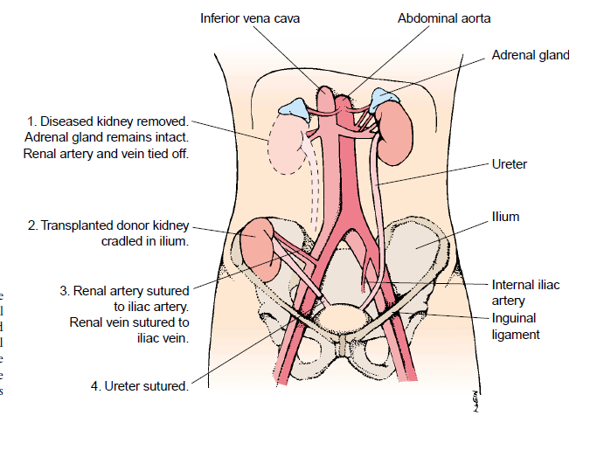

Slide 216
Kidney Transplantation
Advantages of kidney transplant compared with dialysis
Reverses many of the pathophysiologic changes associated with renal failure
Eliminates the dependence on dialysis
Less expensive than dialysis after the first year

Slide 217
PREOPERATIVE MANAGEMENT
Preoperative management goals include
bringing the patient’smetabolic state to a level as close to normal as possible,
Making sure that the patient is free of infection,
preparing the patient for surgery and the postoperative course

Slide 218
Medical Management
A complete physical examination is performed.
Tissue typing, blood typing, and antibody screening-compatibility.
Other diagnostic tests must be completed to identify conditions requiring treatment before transplantation.
The patient must be free of infection at the time of renal transplantation—Medications are used to suppress immune function to avert rejection.

Slide 219
A psychosocial evaluation is conducted to assess the patient’s ability to adjust to the transplant.
A history of psychiatric illness is important to ascertain-corticosteroids exercarbate psychiatric illness.
Hemodialysis is often performed the day before the scheduled transplantation procedure to optimize the patient’s physical status.

Slide 220
Nursing Management
The nursing aspects of preoperative care are similar to those for patients undergoing other elective abdominal surgery.
Patient teaching addresses
pain managementoptions,
dietary restrictions,
intravenous and arterial lines, tubes
(indwelling catheter and possibly a nasogastric tube),
ambulation.

Slide 221
POSTOPERATIVE MANAGEMENT
The goal of care is to maintain homeostasis until the transplanted kidney is functioning well.
The patient whose kidney functions immediately has a more favorable prognosis than the patient whose kidney does not.

Slide 222
Immunosuppressive Therapy
The survival of a transplanted kidney depends on the ability to block the body’s immune response to the transplanted kidney.
Immunosuppressant agents such as
azathioprine (Imuran),
Corticosteroids (prednisone),
cyclosporine, and
OKT-3 (a monoclonal antibody)
are administered.

Slide 223
The newest class of agents, the first of which is sirolimus, is called target of rapamycin (TOR) inhibitors;
These agents are used with cyclosporine for maintenance therapy.
The patient will, however, take some form of antirejection medication for the entire time that he or she has the transplanted kidney.

Slide 224
When toxic levels are reached, both cyclosporine and tacrolimus may produce a clinical spectrum that varies from tremor and acute confusional state to status epilepticus and major speech or language abnormalities.

Slide 225
Postoperative Nursing Management
ASSESSING THE PATIENT FOR TRANSPLANT REJECTION.
assesses the patient for signs and symptoms of transplant rejection:
oliguria, edema, fever,
increasing blood pressure,
weight gain, and swelling or
tenderness over the transplanted kidney or graft.

Slide 226
Patients receiving cyclosporine may not exhibit the usual signs and symptoms of acute rejection.
The only sign may be an asymptomatic rise in the serum creatinine level (more than a 20% rise is considered acute rejection).
The patient is closely monitored for infection because of susceptibility

Slide 227
PREVENTING INFECTION
Infection may be introduced through the urinary tract, the respiratory tract, the surgical site, or other sources
Urine cultures are performed frequently
Catheter and drain tips may be cultured when removed
The nurse ensures that the patient is protected from exposure to infection by hospital staff, visitors, and other patients with active infections.

Slide 228
Careful hand hygiene is imperative; facemasks may be worn by hospital staff and visitors to reduce the risk for transmitting infectious agents while the patient is receiving high doses of immunosuppressants.
Reverse barrier Nursing

Slide 229
MONITORING URINARY FUNCTION
Hemodialysis may be necessary postoperatively to maintain homeostasis until the transplanted kidney is functioning well
A kidney from a living donor related to the patient usually begins to function immediately after surgery and may produce largequantities of dilute urine.

Slide 230
A kidney from a cadaver donor may undergo acute tubular necrosis and therefore may not function for 2 or 3 weeks,
during which time anuria, oliguria, or polyuria may be present.
During this stage, the patient may experience significant changes in fluid and electrolyte status.
The output from the urinary catheter is measured every hour

Slide 231
ADDRESSING PSYCHOLOGICAL CONCERNS
The rejection of a transplanted kidney remains a matter of great concern to the patient, the family, and the health care team for many months.
Anxiety and uncertainty about the future and difficult post transplantation adjustment are often sources of stress for the patient and family
An important nursing function is the assessment of the patient’s stress and coping.

Slide 232
nurse uses each visit with the patient to determine if the patient and family are coping effectively .
If indicated or requested, the nurse refers the patient for counseling.

Slide 233
MONITORING AND MANAGING POTENTIAL COMPLICATIONS
careful assessment for the complications related to renal failure and those associated with a major surgical procedure are important aspects of nursing care.
Strategies to promote surgical recovery
breathing exercises,
early ambulation,
care of the surgical incision) areimportant aspects of postoperative care.

Slide 234
GI ulceration and corticosteroid-induced bleeding may occur.
Fungal colonization of the GI tract and urinary bladder may occur secondary to corticosteroid and antibiotic therapy.
patient is monitored closely for signs and symptoms of adrenal insufficiency if the treatment has included use of corticosteroids. (Adddisons disease)

Slide 235
Care of the Patient Undergoing Kidney Surgery
Nursing Diagnosis: Ineffective airway clearance related to pain of high abdominal or flank incision, abdominal discomfort, and immobility; risk for ineffective breathing pattern related to high abdominal incision
Goal: Relief of pain and discomfort

Slide 236
Interventions
1. Administer analgesics as prescribed.
2. Splint incision with hands or pillow to assist patient in coughing.
3. Assist patient to change positions frequently.
4. Encourage use of incentive spirometer if indicated or prescribed.
5. Assist with and encourage early ambulation.

Slide 237
Nursing Diagnosis: Acute pain and discomfort related to surgical incision, positioning, and stretching of muscles during kidney surgery
Goal: Relief of pain and discomfort

Slide 238
Interventions
1. Assess level of pain.
2. Administer analgesics as prescribed.
3. Apply moist heat and massage to areas with muscular aches and discomfort.
4. Splint incision with hands or pillow during movement or deep breathing and coughing exercises.
5. Assist and encourage early ambulation

Slide 239
Nursing Diagnosis: Fear and anxiety related to diagnosis, outcome of surgery, and alteration in urinary function
Goal: Reduction of fear and anxiety

Slide 240
1. Assess patient’s anxiety and fear before surgery if possible.
2. Assess patient’s knowledge about procedure and expected surgical outcome preoperatively.
3. Evaluate the meaning alterations resulting from surgical procedure have for patient and family or partner.
4. Encourage patient to verbalize reactions, feelings, and fears.
5. Encourage patient to share feelings with spouse or partner.
6. Offer and arrange for visit from member of support group (eg, ostomy group, if indicated).

Slide 241
Nursing Diagnosis: Impaired urinary elimination related to urinary drainage;
risk for infection related to altered urinary drainage
Goal: Maintenance of urinary elimination;
infection-free urinary tract

Slide 242
1. Assess urinary drainage system immediately.
2. Assess adequacy of urinary output and patency of drainage system.
3. Use asepsis and hand hygiene when providing care and manipulating drainage system.
4. Maintain closed urinary drainage system.
5. If irrigation of the drainage system is necessary, use gloves and sterile irrigating solution and a closed drainage and irrigation system.

Slide 243
6. If irrigation is necessary and prescribed,carry it out gently with sterile saline and the prescribed amount of irrigating fluid.
7. Assist patient in turning and moving in bed and when ambulating to prevent displacement or inadvertent removal of urinary stent or ureteral catheters if in place.
8. Observe urine color, volume, odor, and components.
9. Minimize trauma and manipulation of catheter, drainage system, and urethra.

Slide 244
10. Clean catheter gently with soap during bath, avoiding any to-and-fro movement of catheter.
11. Anchor drainage tube.
12. Maintain adequate fluid intake.
13. Assist with and encourage early ambulation while ensuring placement of urinary drainage system.

Slide 245
Nursing Diagnosis: Risk for imbalanced fluid volume related to surgical fluid loss, altered urinary output, parenteral fluid administration
Goal: Normal fluid balance will be maintained.

Slide 246
1. Weigh patient daily.
2. Take accurate intake and output measurements.
3. Place all parenteral therapy on an infusion pump.
4. Monitor amount and characteristics of urine.
5. Monitor vital signs: temperature, pulse, respirations, and blood pressure.
6. Auscultate heart and lungs every shift.

Slide 247
THANKYOU

